Slide 1




Slide 2






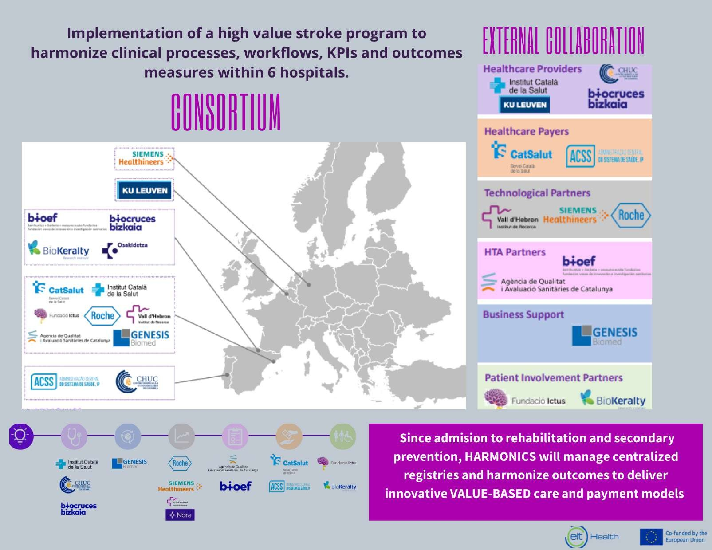















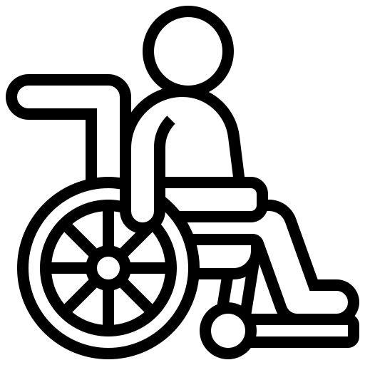



CONSORTIUM
EXTERNAL COLLABORATION
Implementation of a high value stroke program to harmonize clinical processes, workflows, KPIs and outcomes measures within 6 hospitals
Healthcare Providers
Healthcare Payers
Technological Partners
HTA Partners
Business Support
Patiennt Involvement Partners
Since admission to rehabilitation and secondary prevention HARMONICS will manage centralized registries and harmonize outcomes to deliver innovative VALUE-BASED care and payment models.

Slide 3
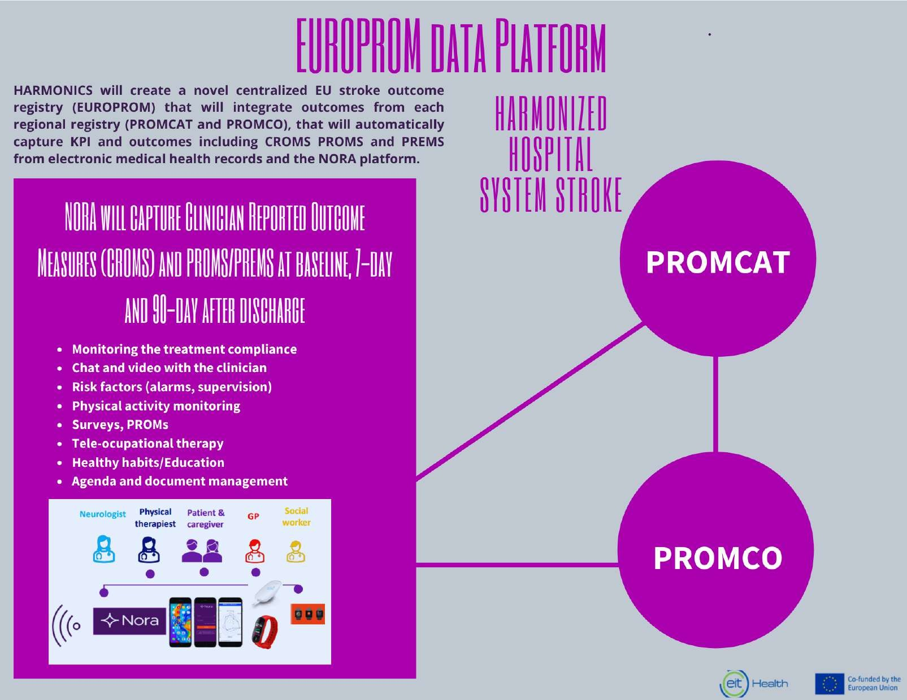
EUROPROM DATA PLATFORM
HARMONICS will create a novel centralized EU stroke outcome registry (EUROPROM) that will integrate outcomes from each regional registry (PROMCAT and PROMCO), that will automatically capture KPI and outcomes including CROMS, PROMS and PREMS from electronic health records and the NORA platform.
HARMONIZED HOSPITAL SYSTEM STROKE
NORA WILL CAPTURE CLINICIAN REPORTED OUTCOME MEASURES (CROMS) AND PROMS/PREMS AT BASELINES, 7-DAY AND 90-DAY AFTER DISCHARGE.
Monitoring the treatment Compliance
Chat and video with the clinical
Risk factors (alarms, supervision)
Physical activity monitoring
Surveys, PROMs
Tele-ocupational therapy
Healthy habits/Education
Agenda and document management
PROMCAT
PROMCO

Slide 4


STAY TUNED!
@HarmonicsEit
HARMONICS EIT HEALTH
CONTACT US!
proyectoharmonics@gmail.com

